Slide 1
International Student Roundtable and Summit
Summary of work effort
September 2021 – June 2022

Slide 2
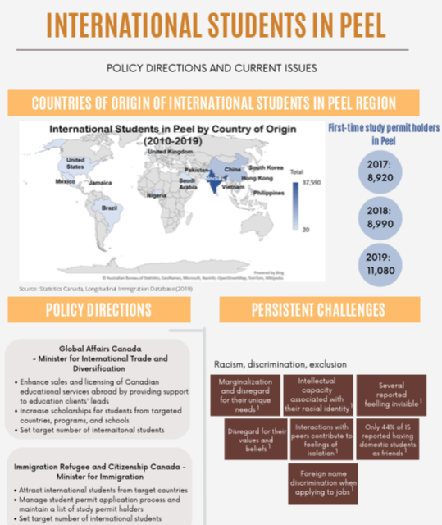
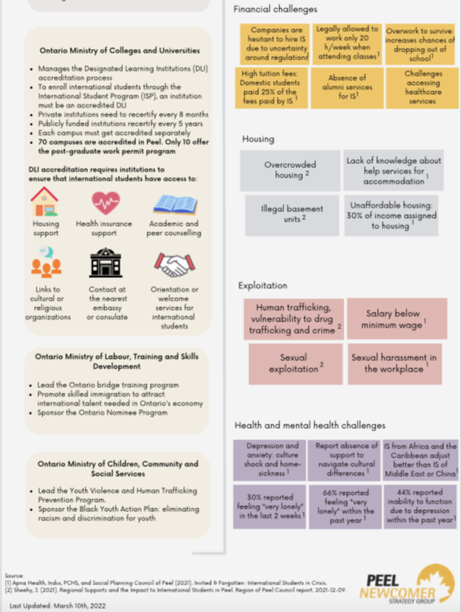
The system is broken … and it’s causing harm
Notes:
Over the past 6 months, an increasing number of stories have appeared in mainstream media outlets, highlighting the struggles of international learners in Canada.
And while this is a challenge that’s shared right across the country, we also know that Peel Region — and particularly the City of Brampton — is home to a very large population of international students who attend numerous private and public educational institutions, both within the city and beyond its borders.
Studies by Apna Health, One Voice Canada, Peel Newcomer Group and the Auditor General of Ontario have each documented different parts of the problem and made suggestions about what can be done.

Slide 3
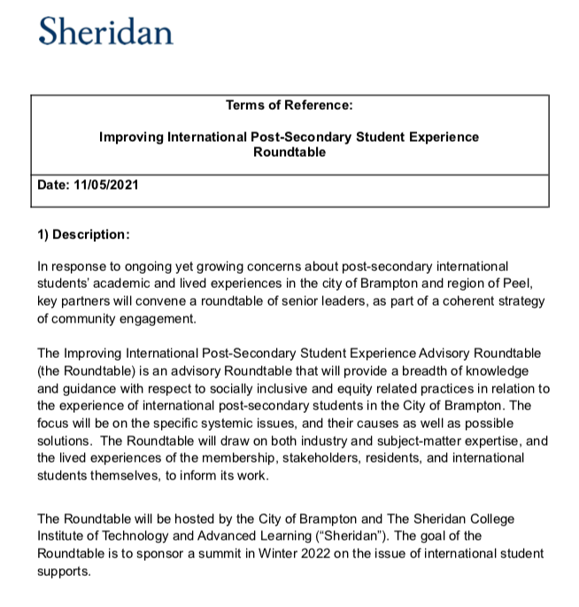
Making Brampton the best practice leader
for the international student experience
Co-chairs
Gurpreet Malhotra, CEO, Indus Community Services
Bill Boyes, Fire Chief, City of Brampton
Members at large
Baldev Mutta, Chief Executive Officer, Punjabi Community Health Services
Dr. Janet Morrison, President & Vice-Chancellor, Sheridan College
Rowena Santos, Councillor, City of Brampton
Janice Sheehy, Commissioner, Region of Peel
Dr. Kate Bingham, Acting Medical Officer of Health, Region of Peel
Chief Nishan Duraiappah, Peel Regional Police
Dr. Rardi van Heest, Vice President Medical Affairs, Research & Academics, William Osler Health System
Sharanjeet Kaur, Former Director, Executive Projects and Operations, William Osler Health System
Todd Letts, CEO, Brampton Board of Trade
Jaspreet Kaur Bal, Ontario Vice President, World Sikh Organization
Sinthusha Panchalingam, Clinical Director, Canadian Mental Health Association, Peel Dufferin
Jaspreet Singh, Founder, International Students’ Association
Dr. Amira El Masri, Director, Centre for Global Education and Internationalization, Sheridan College
Secretariat
Jaskaran Sandhu, Principal, State Strategy
Rajan Sandhu, VP Strategic Alignment and General Counsel, Sheridan College
Christine Szustaczek, VP External Relations, Sheridan College
Nauman Khan, AVP Government Relations, Sheridan College
Keera Smiechowicz, Executive Assistant, Sheridan College
Notes:
In fall of 2022, a group of community leaders was convened by the City of Brampton and Sheridan College to tackle these challenges head on, in a grass-roots, community-driven effort.
The idea was to engage key stakeholders to share knowledge on the issues, their experiences, the causes of the problems and some suggested solutions. This was done with a view to planning and hosting a summit that would engage any interested members of the broader community to help us create recommendations that will improve the academic and personal experiences of international postsecondary students living in Brampton.

Slide 4
Collective Impact
Five conditions for success:
Common Agenda
Shared measurement systems
Mutually reinforcing activities
Continuous Communication
Backbone support organizations
Notes:
In planning the Roundtable’s work, we turned to the Collective Impact model — first published in the Stanford Social Innovation Review — for inspiration.
The model provides a framework for tackling complex problems or large-scale social change efforts.
The model is based on cross-sector coordination — not the sum of isolated interventions or actions by individual organizations.

Slide 5
A Four-Step Process
Over the past six months, our roundtable has met five times
Plan a summit and draft a charter
Define the Problem
Build on what we know
Identify solutions
Notes:
The Roundtable members — our advisory group — met five times over the fall and winter and their work is broken down into four key steps.

Slide 6
Step #1
Mental health, substance use, and suicides
High barriers for student health and wellbeing
International students lack personal safety nets, and access to government ones either by design or unintentionally
Exploitation by immigration consultants, employers, landlords, and others
Ensuring private sector players providing international students with quality services
Precarious living and working conditions
Lack of a holistic approach (pre-arrival to post graduation) between all levels of government, educational institutions, local community, and employers
Insufficient or inaccessible culturally appropriate resources
Financial support pressures (e.g. medication, rent, tuition), income support and work-integrated learning
High postsecondary tuitions and lack of resources for students
Barriers to permanent resident status
Accountability
Define the Problem
Notes:
Our first meeting asked all Roundtable members to talk about why they wanted to contribute to this effort and their vision of success. We also asked them to identify the experiences and challenges that they are seeing first-hand, so that we could define the problem we wish to tackle. What you see on this slide are the top issues that came to mind for our partners.

Slide 7
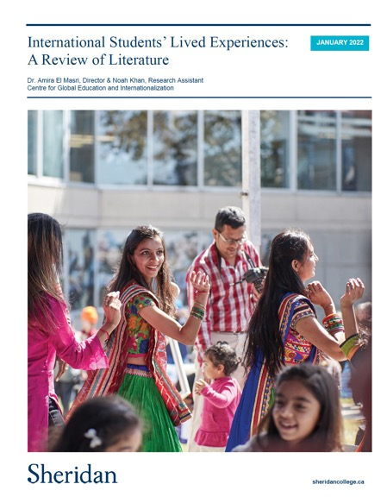
Step #2
Report Highlights
Government policy positions international education as a pipeline to immigration resulting in a steady increase of students since the mid-2000s, with Ontario being the largest beneficiary.
Many students embark on this journey as a pathway to a post-graduate work permit and permanent residency with colleges receiving much of the enrolment as their programs are strongly tied to labour markets.
Peel Region is home to 80 postsecondary campuses that are considered Designated Learning Institutions (DLIs) that can enrol international learners, however only 13 of these DLIs offer programs that enable international students to be eligible for a post-graduate work permit.
Little or no data is publicly available about the practices and enrolments of private career colleges.
Many international students face issues of affordability and possible exploitation by multiple actors and they may lack understanding of their rights and responsibilities.
Based on these findings, a key recommendation of the report is increased collaboration between all community stakeholders who touch the lives of international students along their journey, from pre-arrival to Canadian citizenship.
Build on what we know
Notes:
Next we examined what is already known about the topic by reviewing 129 published works that discuss the lived experiences of international students and what has been already proposed to address the challenges that they face during three key stages: before arriving in Canada; during their postsecondary studies; and throughout their transition to the Canadian labour market.

Slide 8
Step #3
Pre-arrival | During studies in Canada | Transition to labour market
Transparency on cost of living and fee structures | Housing | Settlement services (federal support for students and their family members)
Regulation/oversight of agents and recruiters | Integration of support services (one stop model) | Immigration – permanent residency policy and program review
Sharing verification process and quality standards | Academic support | Increasing 20 hr/week work cap
Pre-departure orientations and formal onboarding | Financial support | Networking and mentorship programs
Early discussion about post-graduate work permits and immigration matters | Mentorship, community and cultural programming | Opportunity to apply for federal summer jobs
 | Health insurance | Career counselling
 | Data sharing and reporting - Quantify number of international learners living in Brampton | Job fairs and support to help local employers hire international students
 | Regulation, accountability and quality standards for private colleges | Education on employment rights and responsibilities
Identify Solutions
Notes:
Next, we asked our Roundtable members to think about short-, medium- and long-term interventions that could help international students at all stages of their journey.
Specifically, we asked: What could community agencies do to help? What are the government policy solutions? And what are solutions that could be provided by postsecondary institutions?
What you see on the screen are the high-level themes that came out of this exercise, which generated more than 150 suggestions.

Slide 9
Step #4
Features
Workshops - draft target commitments and define suggested solutions
Best practice presentations/case studies
Keynote – international students
Action focused with call to action
Lasting with clear actions and owners
Accountability for actions
Desired outcomes
Create Brampton International Education Charter
Research studies (abstracts/displays)
Federal and provincial representatives/decision-makers must participate
Profile those who are doing it right
Key milestones for all to achieve and a timeline
Plan a summit and draft a charter
Notes:
Our work at the Roundtable culminates in a two-day summit, happening on July 25 and 26 at Sheridan College, which is open to anyone in the community who touches the lives of international students or who is interested in this topic.
We’ll recap the work done by the Roundtable, have inspiring keynotes by international students who will share their experiences, and present best-practice examples related to government or policy interventions, postsecondary practices and service provision by community agencies.
While this is an in-person event, these keynotes and panel discussions will be livestreamed. The concurrent breakout sessions will allow participants to refine recommendations and solutions.

Slide 10
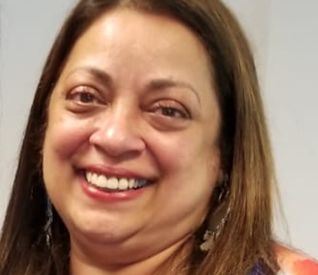
Summit Facilitator
Roopa Desai Trilokekar
Associate Professor, Post-Secondary Education
Faculty of Education, York University
20 years of experience as an international student advisor
International education administrator in 3 countries
Over $500K in federal and provincial funding for research to impact policy and practice
Part of the International Student Advisory Group of the Peel Newcomer Strategy Group
Notes:
I’d also like to introduce Council to our Summit Facilitator, who has just joined this project.
Roopa Desai Trilokekar comes to an academic career after 20 years of experience as a professional administrator in the field of international education in Canada, India and the U.S.
Her research focuses on government policy on international education, its links and impact on higher education and the international student experience.

Slide 11
Desired Outcome: Create the Brampton Charter for the International student experience
Notes:
All of our efforts at the summit will form the basis of a Brampton Charter: This will be our action plan to live up to our vision of making Brampton the best-practice leader in Canada for the international student experience.
Similar to other charters shown here, our Brampton Charter will outline guiding principles, actions or recommendations for adoption by all parties, and a mechanism for accountability.
In this way, it will provide us all with a common agenda and shared measurement system, which we saw was critical to implementing a Collective Action response to a large-scale social change agenda.

Slide 12
Next Steps
August
December
July
25 & 26
Sept- Nov.
2023
Signing Ceremony
for
Brampton Organizations
Gather community feedback on draft
Charter
International Student Summit
Draft
the Charter
Share the Charter nationally
Notes:
To close out our delegation, I’d like to quickly summarize our next steps.
Following the summit in July, we will review all the draft recommendations from the breakout sessions, and they will create the first draft of our charter.
We will then spend three months — September, October and November — sharing this charter with as many community groups, faith groups, business associations and interested residents as possible to get feedback on our draft and additional input, recognizing that not everyone might be able to attend the summit in July.
Our aim is to plan a signing ceremony in Brampton in December for all interested non-profits, governments, businesses, agencies, and postsecondary institutions (public and private) who wish to signal their meaningful commitment to improving the international student experience.
Next year, we will undertake an effort to share this charter with communities across Canada to inspire them to adopt something similar.
Thank you.

